Slide 1

How to Architect Adobe LiveCycle ES into your Enterprise Solutions
Oct 7th - #adobemax343
Danny Saikaly Technology Practice Leader
Technology and Experience Innovation / Professional Services
Notes:
Welcome to MAX im Danny Saikaly a tech leader NA and part of the proservices and TXI groups within Technical sevices organization.
Just a bit of background, I’ve been architecting solutions with the LiveCycle family of products for about 10 years now and pretty exited about its next release as LiveCycle has really come a long way in the last 2 years.
For the ones of you who like to tweet we have a tweet for this session .You can tweet this session using these iD’s

Slide 2
What we aim to cover in the next 70 minutes…
Things to consider when architecting an enterprise application
Integration and implementation details to make your deployment successful
Identifying the LiveCycle components to address your needs
Addressing common solution patterns with LiveCycle
3 real world Professional Services implementations
Notes:
Question: How many in room have not worked with LiveCycle in one form or another. Show of hands.
Question: How many in the room are not architects?

Slide 3
Agenda
Using LiveCycle out of the box
Integrating LC into a larger solution
Example Implementations
NA Financial Institution
World Bank
Large US Federal Agency
Summary
Q&A

Slide 4
Definition
ar·chi·tec·ture (ärk-tkchr) n.
Computer Science The overall design or structure of a computer system, including the hardware and the software required to run it… http://www.thefreedictionary.com/architecture

Slide 5
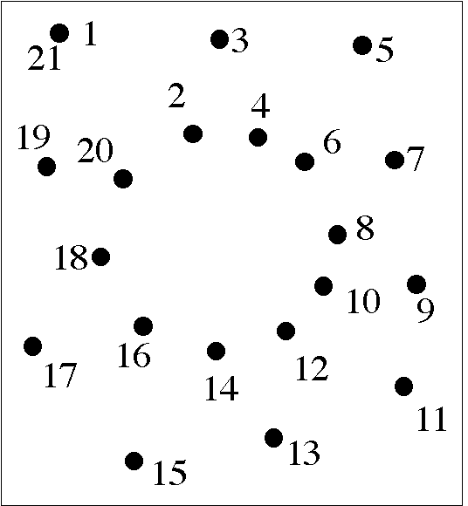
Connecting the ……
Notes:
Architecture in my view and perspective is about connecting the dots. This is the approach I always take when tackling a solution.
Identifying the dots, size of the dot, the characteristics of the each of dots, if they can be connected to and so on..
Once the dots are connected, you can build out your solution with reduced risk and reduced complexity.
In this example who can tell me what the end application looks like.

Slide 6
Using LiveCycle out of the box

Slide 7

OOB Functionality Overview
Data Capture
Information Assurance
Document Output
Process Management
Content Services
Notes:
5 major component areas or modules
-They are Data capture, as the name indicates is around capturing data electronically
-Information assurance around security digital signatures,
-Document output as the icon indicates are components that provide server-side printing or the creation of non-interactive PDF generation ,
-Process management is around human centric workflows and monitoring
And last but not least is the good old filling cabinet, content services to store/archive your documents of record

Slide 8
OOB Functionality Overview
LiveCycle Forms ES Deploy interactive XML-based forms in Adobe Reader®, Adobe Flash® Player, or web browsers.
LiveCycle Reader Extensions ES Fill in, sign, comment on, or save Adobe PDF files using only Adobe Reader software.
LiveCycle Barcoded Forms ES Automate the capture of form data using dynamic 2D barcodes.
LiveCycle Data Services ES Integrate rich Internet applications (RIAs) with LiveCycle services, J2EE applications, and business logic.
LiveCycle Rights Management ES Manage usage rights to protect sensitive documents in PDF, office, or CAD formats.
LiveCycle Digital Signatures ES Automate the signing, certification, and validation of digital signatures in PDF documents.
LiveCycle PDF Generator ES Automate the creation and assembly of PDF documents from virtually any file format.
LiveCycle PDF Generator 3D ES Automate the creation and assembly of PDF documents from engineering product data.
LiveCycle Output ES Dynamically generate personalized documents on demand in print and electronic formats.
LiveCycle Production Print ES Dynamically generate personalized documents for high-volume production environments.
Data Capture
Information Assurance
Document Output
Notes:
-Just to run through these various components at a high level and for anyone new to livecycle to make you ware of what's available with the suite of products.
-These components are all provided out of the box
-Run through the components at a high level

Slide 9
OOB Functionality Overview
LiveCycle Process Management ES Streamline human-centric business processes across your firewall.
LiveCycle Business Activity Monitoring ES Monitor, analyze, and tune your LiveCycle ES applications.
LiveCycle Content Services ES Store, manage, and collaborate on the content used in your LiveCycle ES applications.
LiveCycle ES Connectors for ECM Extend your LiveCycle ES applications to connect with industry-leading ECM systems.
Process Management
Content Services

Slide 10



















Architecture & Solution Component Design
User Experience
Multiple Channels
Online
Call Center
Branch
Agent/ Field
Mail & Fax
Email
Mobile
Multiple Platforms
Tools
LiveCycle Services
Solution
Accelerators
RIA Core
Mosaic
Data
Capture
Information Assurance
Document
Output
Creative
Suite
Enterprise RIA Services
Document Services
Flash
Catalyst
Solution Guides
Process Management
Flash
Builder
Content Services
Solution templates
LiveCycle
Workbench
Foundation
Building blocks
EXISTING APPLICATIONS & SYSTEMS
ECM Repository
Message Queues
Directories
Databases
Enterprise Information Systems
Legacy Systems
PUBLIC CLOUD
Services

Slide 11

Integration
I
SOAP
REST
Flex
Remoting
File
System
Email
Java
Notes:
inbound

Slide 12
Integration
I
SOAP
LDAP
REST
JDBC
FTP
JMS
File
System
Documentum
Email
FileNet
Java
IBM CM
Notes:
outbound

Slide 13
Integrating LC into a larger solution

Slide 14
What you need to consider?
Your users!
Requirements
An existing environment
Client -side software/hardware/architecture
Deployment, load balancing clustering, disaster recovery
Servers – OS, database, JVM, shared drives, email, LDAP, application
Security – SSL, data encryption , DRM
Performance – it needs to be fast!
Integration points – SOA, JMS, remoting , watch folders
Your data
Notes:
-When architecting a solution that are always things you need to take into consideration to ensure your are successful. Some of these consiedartion my be obvious to some but not others.
-The first and foremost are your users.
-Your are architecting and building a solution usually to address their needs not yours.
-The requirements and the functionality or purpose behind the requirements. What are you trying to build?
-What environments are you currently dealing with? Does livecycle supported on these environments? We will look at the platform matrix shortly
-Don’t forget about the clients side of things like reader versions, flash player and browsers. In some enterprises, these products and browser will have limited functionality so be aware.
-Most application are critical to the mission of the business so consider cluster, single point of failures and of course disaster recovery
-Hardware and other systems that will support you application, base or common systems as I like to refer to it. Ldap Email etc.
-Security. I tell all my clients this. No system is and will every be 100% secure. The goal of security is to make it to considerably reduce malicious intent and access.
So how fast is fast? Is it really fast? Not a constrain or non- functional requirements unless you define qualitatively in a unit of measure. 3 sec per transaction etc. Mother nature has always taught us the large something is the slower it moves. Although I keep tell my kids that I can out run them in a race or out skate them around the rink.
How are these systems suppose to talk to each other. Indentify you inbound and out bound points of integartions.
Its all about the data. Pay attention on its structure, its size, the type of data, prinmtaive or binary in the form of a document for instance.

Slide 15
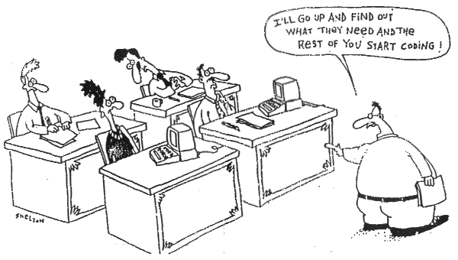
Requirements
Notes:
-I have this n my office and when the team comes and asks me about a specific problem they need to solve or an approach, I alwast go back to them and say, whatis the requirmment so that I can get a full picture and understanding of the situation.
-Discuss over the whiteboard…

Slide 16
What you need to consider?
Network considerations
Cache management
Transaction execution
Outside the firewall
Environmental Considerations
3rd-Party products
User accounts
Virtualization
# of environments
Disk I/O
Any existing integration points
Your users!
Notes:
So is your network a potential constrain to the solution. Some of the banks I have worked with over the last 10 years have these super dooper data centers, elevetd flors multiple fiber optic lines but have a split ISDN basically 56K modem to each of the branches.
When integrating with a 3rd party system
If you plan on virtuilize the solution, consider disk i/o
Last and certainly not least again your users!

Slide 17
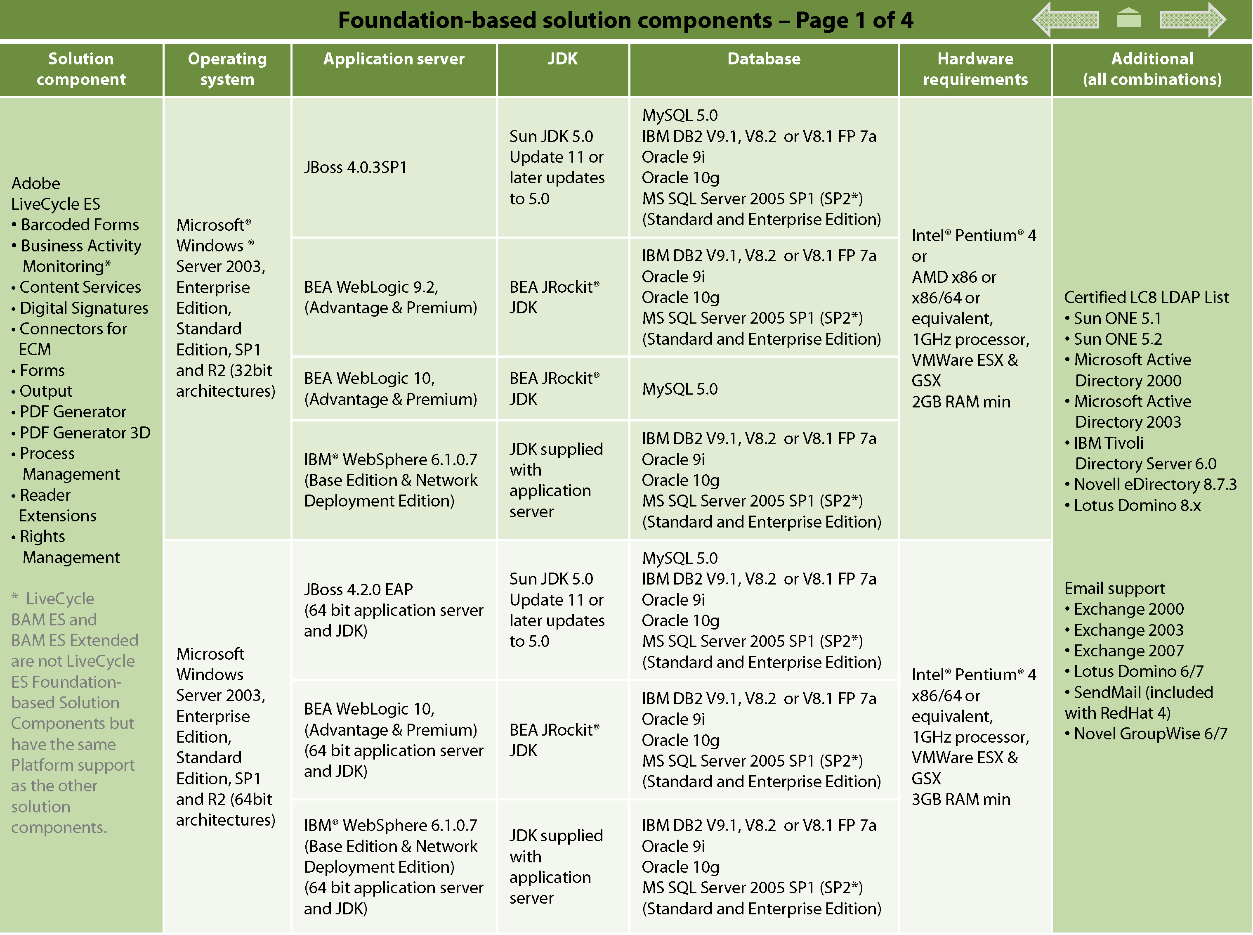
Platform matrix
http://www.adobe.com/products/livecycle/pdfs/lces_update1_sysreqs.pdf
Notes:
Platform matrix,
leverage exiting hardware if possible
-Before starting the procurement process or repurposing existing hardware, please refer to the platform matrix for ES to ensure that the system requirements have been met.
-Yes believe it or not this is overlooked too many times and not even considered.
-Please refer to the link below to get the full comprehensive matrix from adobe.com

Slide 18
Design and Integration
More than just creating architecture /UML diagrams
Tendency is to tackle the technology and focus on “technical requirements”
Avoid “Lets start coding” cowboy mentality
Understating the current domain/ solution that has been deployed (Discovery)
How does it affect the users?
Need to consider
Usability, maintainability, modularity, packaging, reusability, security
Understand the current environment and which components need to be augmented/changed
Notes:
-Things to consider from a design an integration perspective.
-Design is much more that just creating a bunch of UML diagrams
Just a show of hands how many of think everything can be tackled technically. Any of you been on a conference call and the first thing that comes out is yes we can create webservcie and then interface that with the DB…
And the next thing you do is fire up your IDE or put a sample together to demonstrate what they are trying to articulate?
Since so many architects are technical by nature we want to start cowboy coding the requirements. Im also guilty of that but you need to take a step back and really understand the potential impact to the solution and your design. Avoid cowboy coding.
Really trying to understand the domain your dealing with. We call this in professional services our Discovery phase. Its basically broken into a user, buiness and techcail discovery. This all occurs before you start to define the projects.
Remember our first consideration from the previous slides, remember the users how does it effect them via the UI.
When designing with LiveCycle always keep in mind the following UMMPRS.
- Don’t underestimate this one. What needs to remain the same, change or gets replaced at a component level.

Slide 19
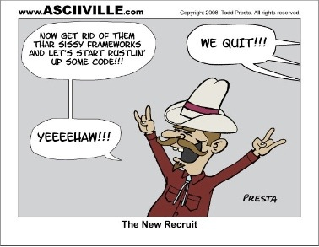
Cowboy Coding

Slide 20
Design and Integration
Do we need to modify existing services to support the new functionality?
Division of labor - Who is doing what?
Separate your design into logical sections- (divide and conquer)
Start small and then go large
i.e. pass 1 or 2 data elements to establish a valid connection
Add additional elements to your domain/ schema
Identify repeatable patterns
Validation routines on data capture
Rendering operations
Variable re-use
Think atomic services
KIS – Keep it simple !
Notes:
-Do we need change existing services or production application using these services?
-Who owns what and when are they going to get it completed for you.
-Im a big fan of this next one no matter how big your application is if you divided it into logical section and then conquer thoses section, you have a far greater chance of success than tackling everything at one. Release early and often.
-pass 1 or 2 fields as oppose to an entire schema when estalish a handshake or intergration with another system.
-Build upon this foundation and start to add more data, and functionality
-identify and areas of reusablity and any common pattersn Some are validation rountines, rebdering operasstions. Also looking to the solution accelersators building blocks that provide some of the most common design patterns already for you.
Always think atomic when building services or aggregating services with LiveCycle .
An keep your design simple. I’ve seen too many projects get too complicated when the same functionality could have been achived with a few steps using a different approach

Slide 21
Implementation
Coding Standards
Forms
Custom components
Avoid hard-coded literal values
Exception Handling
Service Implementation
Process granularity
Design of the API for external consumers
Ensure the process is discoverable
Make the operation of the process clear
Document the process requirements
Consider endpoints and access security
Notes:
-So who here loves to comment their code!
-When working on large teams this is just important as the code itself sometimes.
-Apply your standards to allow aspects of your livecycle solution form the XDP forms, to custom DSC, don’t foret to implement execption handling and use the confiuration variable or an external properties file to hold your literal vales.
-

Slide 22
Implementation
Process/Service Versioning
Strict process versioning makes it clear when the process was last updated, and allows the LCA (LiveCycle Archive file) to be as robust and accurate as possible.
Test-Driven Development
Use of an continuous integration server
Customer tests for all scenarios - Happy path and corner cases
Leverage xUnit
Quantity vs. Quality
Configuration Management
Source code version control
Use automation of configuration management LC API’s
Deployment and Promotion
LCA, assets, and whatever gates and processes you need to adhere too.
C
Notes:
-Use LCA to promote your code. Who here has used the LCA to deploy their app between servers.
- Now how many have done it in an automated fashion uinsg using continuous integrations servers like Hudson. In pro services we have taken it to the next level for LCA automation and continuous integration.
-Using test script like Junit or LC unit to test your orchestrations?
-always always using source control for all your forms, processes, componets and assets always. Some improvements with ES2 in this area so stay tuned.
-Define what you process or methodology your are using are and ensure you plan accordingly for each checkpoint.

Slide 23
Implementation 1 NA Financial Account Opening
Notes:
3 implementations. We wont get into the deep level coding but showcase some of the reusability in designing these application and the various methods to make these various services more generic on top of the LiveCycle platform.
-Also we I have protected the innocent and due to the sensitivity nature of some of these organizations and sharing their names, we will refer to them in a generic fashion.

Slide 24
Problem
Needs to streamline account opening process
Taking too long, prone to errors
Currently using print and fill for all applications
Paper workflow
Supports multiple channels – branch, online, phone and manual
Security
New and existing clients
All forms need to be accessible using screen readers
All forms need to be government approved
Needs to go live by Jan 1st
No partying the night before ☹
Notes:
Basically wanted to steam line the account opening process
Taking in upwards of 3 week to open a new account
Where filling out paper and submitting via snail mail and created many forms that were NIGOS
Basically a paper based process
Requirement to Support multiple channels for submission
-wanted to cerate a platform to deploy other forms upon for electric data capture and submission
Currenty has many firewall and web proxies and know to be one of the most secure websites in NA various winning awards in this area
Using jaws for accessibility of PDSF forms
Go live for the first of the year due to regulatory requirements

Slide 25
Project size
50 forms, 1 large workflow and 6 supporting processes
Targeting ~15,000 applications a week
Adobe Professional Services
5 resources: Sr. Project Manager, Technical Architect, 2 Senior Consultants, Technical advisor
Client
12 resources: 4 PM’s, many architects, mainframe admin, offshore QA, operations…
Duration = 9 months
Prototype phase - 2 months
Define and Deliver 2+5 months
Notes:
50 forms some of which leveraged reusable fragments after a forms analysis exercise was completed
-15000 transactions per week mostly during business hours
-

Slide 26
Solution with LiveCycle
Pre-population of account information based on client card number – Forms ES
Data capture via guides and accessible PDF – Forms ES, Designer, Guide Builder
Server-side validation of data integrity- Custom Component Workbench
Initiate a workflow for back-end operations processing – Process Management
Auto printing of application due to internal processes – Output ES
Storage as a document of record in the mainframe - Custom Component Content Services
Notes:
-Structured XML file that validated with and XSD to populate the forms for client information and any reference data to be used,. It was combined into a single master XML file.
-Data capture was done primarily with the Form guide wizard and at time using the PDF form. The shortest route was 3 panels all the up to 12 based on decision points. The Form guide used a custom Flex wrapper to house many of the common client side validation routines so in essence built a framework for other data capturing guides for future use.
-An controller style orchestration for handling the various requests via the ASP front end serving up the guides and PDF
-This controller also initiates the workflow process for data submission and routing and human centric exception handling
-
Validation testing

Slide 27
LiveCycle ES
User Experience
Multiple Channels
Online
Call Center
Branch
Agent/ Field
Mail & Fax
Email
Mobile
Multiple Platforms
Tools
LiveCycle Services
Solution
Accelerators
RIA Core
Mosaic
Data
Capture
Information Assurance
Document
Output
Creative
Suite
Enterprise RIA Services
Document Services
Flash
Catalyst
Solution Guides
Process Management
Flash
Builder
Content Services
Solution templates
LiveCycle
Workbench
Foundation
Building blocks
EXISTING APPLICATIONS & SYSTEMS
ECM Repository
Message Queues
Directories
Databases
Enterprise Information Systems
Legacy Systems
PUBLIC CLOUD
Services

Slide 28
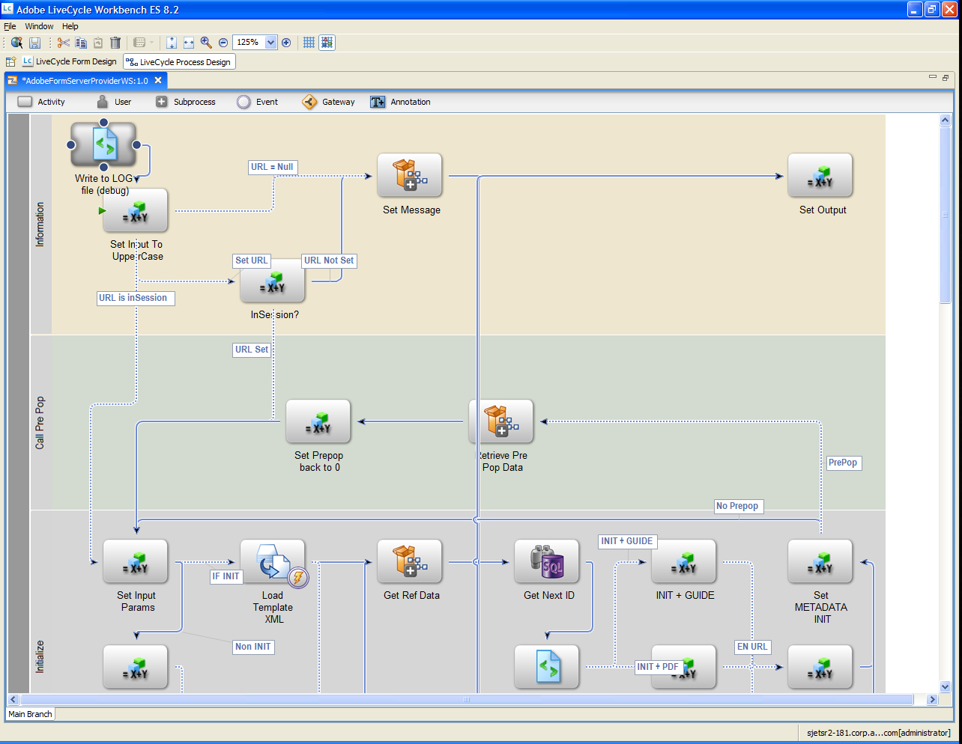
Controller process for their .NET application
Notes:
-Here so a screen shot of the controller process. Basically a flag is sent to distinguish the route and sub process that needs to be called. This is a Short lived process
-The controller is divided logical sections via the by swimlanes

Slide 29
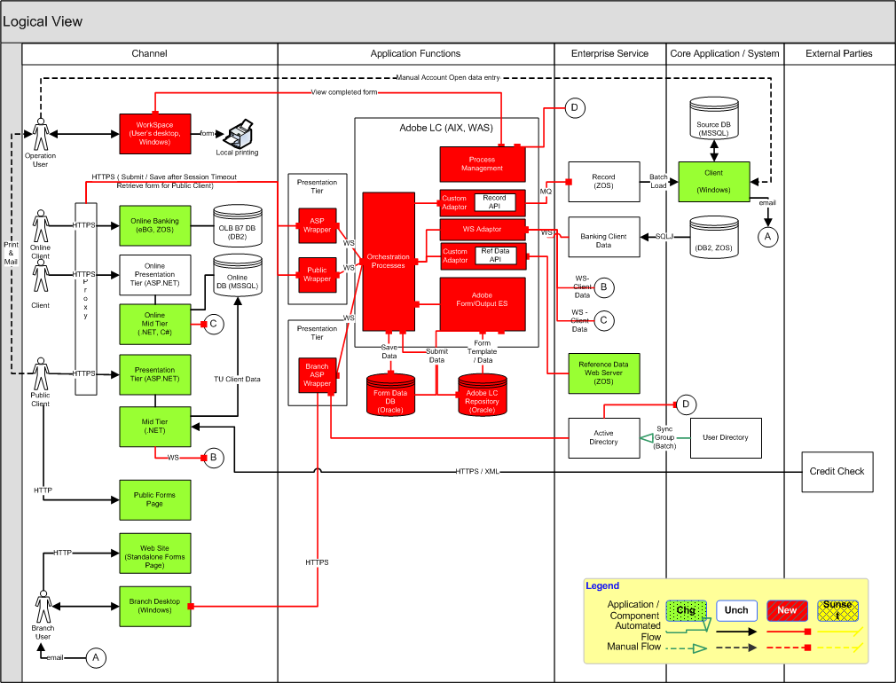
Solution architecture
Notes:
-Here is the solution architecture. 5 major areas. Channel, Application functions, Services, core system and external parties
-Note the color coded areas. The green identifies what has changed, white what remains unchanged and red on whats new, basically Adobe LiveCycle. Yellow distinguish what has been sunset.
-With this diagram, you can understand clearly the impact to your existing architecture and then identify the division of labor and who own want form an interaction perspective.

Slide 30
Implementation 2 World Bank

Slide 31
Problem
Branches worldwide
Support 5 languages, English, French, Spanish, Korean, Bahasa (Indonesia)
Lots of paperwork to do anything
International clients
Creation of legal document package with signatures
Wizard-style data capture that needs to be sent via email
Needs to be secure
Pre-fill some of the know data into the forms
Offline save, submit outside web browser
Notes:
-Some of their challenges are around paperwork was needed to get anything done.
This involved huge mailing costs for distribution worldwide
With international clients you need to be efficient on how data and forms are distributed.
Need to send package via email for offline save and resume functionlaity
Secure submission and view of the document
This is primarily due to the fact that client data in the form was sensitive

Slide 32
Project size
1 MVC Form, multiple languages
5 workflow processes, 1 supporting process for 1 parent process, modularity
~500 corporate accounts, relatively low volume
Adobe Professional Services
3 resources: Sr. Project Manager, Technical Architect, Senior Consultant
Client
5 resources: 2 PM’s, no architects, occasional admin, offshore QA and Knowledge Transfer, operations…
Duration – 12 months
Prototype phase - 4 months
Define and Deliver –3/5 months
Notes:
-MVC – model view controller is a pattern developed in professional services for XFA based for sto hide pages and to allow data capture in a wizard style fashion
-had support for multiple language
-500 corp accounts and in regards to LiveCycle is low volume
-

Slide 33
Solution with LiveCycle
Creation of legal documents – Forms ES and Designer ES
Custom components - Workbench ES
Creating a PDF package of documents - Foundation
PDF package is password protected attachments for additional forms - Digital Signatures ES
Support 5 languages, English, French, Spanish, Korean, Bahasa (Indonesia) – Forms ES
Pre-fill of client data into the forms - Forms ES
PDF offline save, submit outside web browser - Reader Extensions ES
Non-interactive version of final document - Output ES
Notes:
-custom component were created to handle data submission into other system, manipulate the data and the creation of a password generator.
-packaging of pdf’s into a single document via dynamically creating a DDX based on input prameers. DDX is the syntax used to assemble PDF’s and specifyc the order within the document package
-reader extension is used to allow for digital signatures, offline save and resume and submiting data outside of the browser. A speretae orchestration was develop to pre-poputlate all forms.
After the document was submit a copy for archiving PDF was generated using output to create a version for document of record.

Slide 34
LiveCycle ES
User Experience
Multiple Channels
Online
Call Center
Branch
Agent/ Field
Mail & Fax
Email
Mobile
Multiple Platforms
Tools
LiveCycle Services
Solution
Accelerators
RIA Core
Mosaic
Data
Capture
Information Assurance
Document
Output
Creative
Suite
Enterprise RIA Services
Document Services
Flash
Catalyst
Solution Guides
Process Management
Flash
Builder
Content Services
Solution templates
LiveCycle
Workbench
Foundation
Building blocks
EXISTING APPLICATIONS & SYSTEMS
ECM Repository
Message Queues
Directories
Databases
Enterprise Information Systems
Legacy Systems
PUBLIC CLOUD
Services

Slide 35
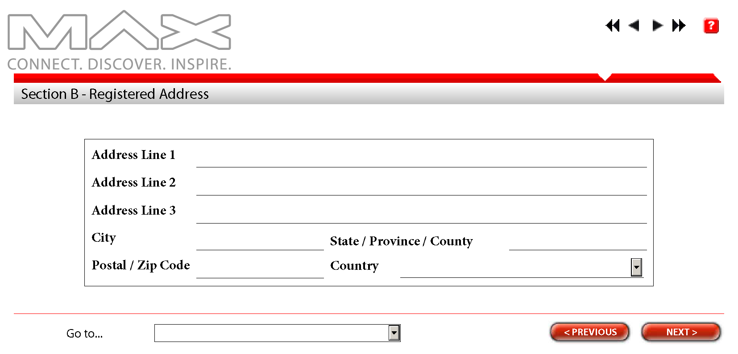
Sample Form
Notes:
-Navigation next and previous
-User navigation to a selected page
-Data collection. Help
-This form is done using Designer ES.
-it uses a technique of hiding and display pages at the right time in order to control what is being displayed to the user.
-great for several panels of data capture
-

Slide 36
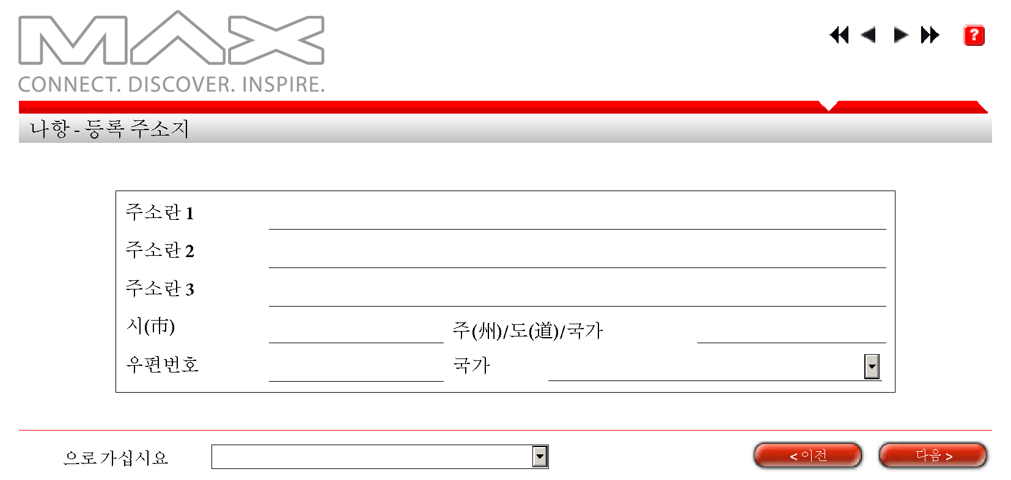
Sample Form
Notes:
-Same as the above screen but using a different language
Text is dynamically added based on language, laugauge is separated from the presentation and drivenat the time of merge with FormsES
-

Slide 37
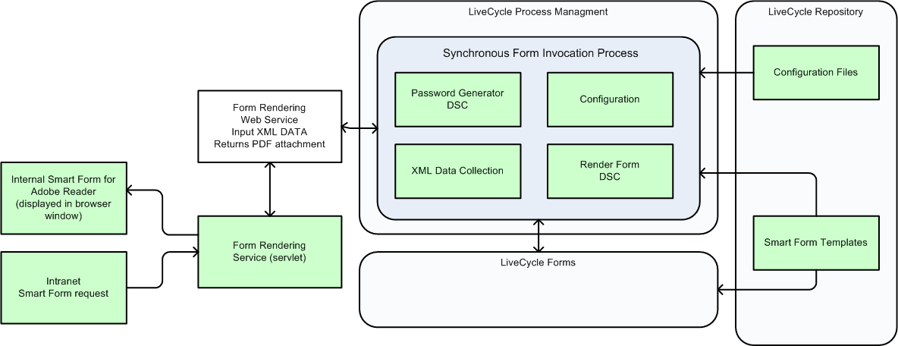
Solution architecture
Notes:
-Referred to as the smart form application. This is one of many diagrams but for simplicity sake will show you only this one.
-Invoked via a servlet to create a level of abstraction.
-using the exposed SOAP endpoint form ES, a generic form rendering service was created. This provides a foundation for which other forms can be rendered.
-A few custom components have been developed. Like the password generator and data manipulation components and configuration components.
-all templates and assets are stored in the repository, version controlled and tagged with a description
-

Slide 38
Implementation 3 Large Federal Agency
Notes:
-Large agency in the US of a 10’s of thousands of employees
-They approach our government team as the technology they currently had in house didn’t really meet their needs and wasn’t flexible
-

Slide 39
Problem
E-Government, Government Paperwork Elimination Act (GPEA)
Form processes is paper-based, manual, lengthy, difficult to track, and wasteful
Need to processes approximately 70,000 forms /month
Multiple steps of approval take several days or weeks via the mail
There is no method of tracking the progress and status of the submission
Each submission package was manually scanned and converted to TIFF files to be stored into the mainframe repository
Notes:
-the compelling factor doing this application was just adhading to the paperwork elimination act but to truly streamline paper based process
-the current process was lengthy to fill out, no tracking and wasteful form and overall efficiency perspective.
-~70 thousand application are being processed each month and wasn’t tracked or data being validated
-tracking and obtaining status on each of the forms was next to impossible to track or locate unless you new the right person to call.
-after the form was completed it was manually scanned to a tiff image. Just think about they had staff just to take the batches of forms that came in daily and each page would get scanned into a tiff image for archiving purposes.

Slide 40
Project size
90 forms, 6 workflows, 7000 users
3000 internal users, 4000 external users
Adobe Professional Services
3 resources: Sr. Project Manager, Technical Architect, Senior Consultant
Client
4 resources: 1 PM, 2 architects, QA
Duration = 10 months
Prototype phase - 2 months
Define and Deliver 3/5 months
Notes:
-After our analysis 90 forms needed to be converted over to the XDP format. Most of the forms were in word for the purposes of printing/
There were 6 distinct workflow process to for the 90 forms to be routed, basically updating various backend systems like DB’s, mainframes etc.
7000 users in 2 different user directories. So you need to consider if users are on both directory. Access from within and outside of the firewall.

Slide 41
Solution with LiveCycle
A web-based and paperless operation environment – Customized Workspace Forms & Output ES
Improve data quality. Data is validated against existing various data sources to ensure data quality – Forms ES
Automate the current form submission processes - Process Management ES
Support multi-level digital signature signing and record tracking
Support Enterprise Service Oriented Architecture (SOA) Foundation
Archiving TIFF images – PDF Generator ES
Integrate with the backend mainframe content management system – Content Services
Support section 508 compliance mandate- Designer & Forms ES
Notes:
-The solution with livecycle looks like the following
-Customized workspace to view forms rather than processes.
-Forms are now submitted via worksapce and starts the appropriate process and then can be tarcked accordingly
PDF G was used to convert the final signed verion ofteh PDF over to TIFF and intgration with their backend system for archiving
Forms were all 508 complinat so test using Jaws was needed.

Slide 42
LiveCycle ES
User Experience
Multiple Channels
Online
Call Center
Branch
Agent/ Field
Mail & Fax
Email
Mobile
Multiple Platforms
Tools
LiveCycle Services
Solution
Accelerators
RIA Core
Mosaic
Data
Capture
Information Assurance
Document
Output
Creative
Suite
Enterprise RIA Services
Document Services
Flash
Catalyst
Solution Guides
Process Management
Flash
Builder
Content Services
Solution templates
LiveCycle
Workbench
Foundation
Building blocks
EXISTING APPLICATIONS & SYSTEMS
ECM Repository
Message Queues
Directories
Databases
Enterprise Information Systems
Legacy Systems
PUBLIC CLOUD
Services
Notes:
Process management
Forms
PDF-G
RE
Output

Slide 43
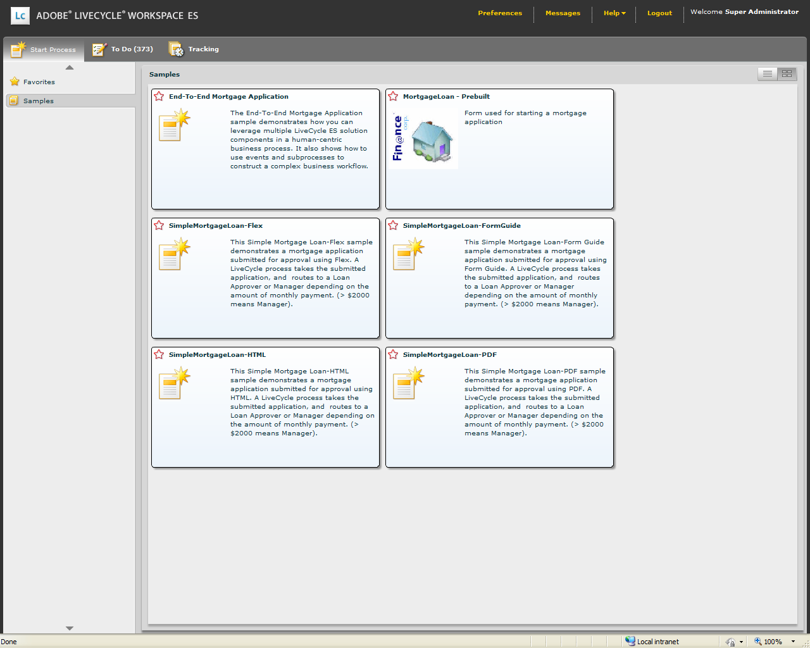
Current Workspace
Notes:
Here is a screen shot of workspace out of the box. Tabs on the top, process categories on the right hand side and thumbnail view in the main part of the screen

Slide 44
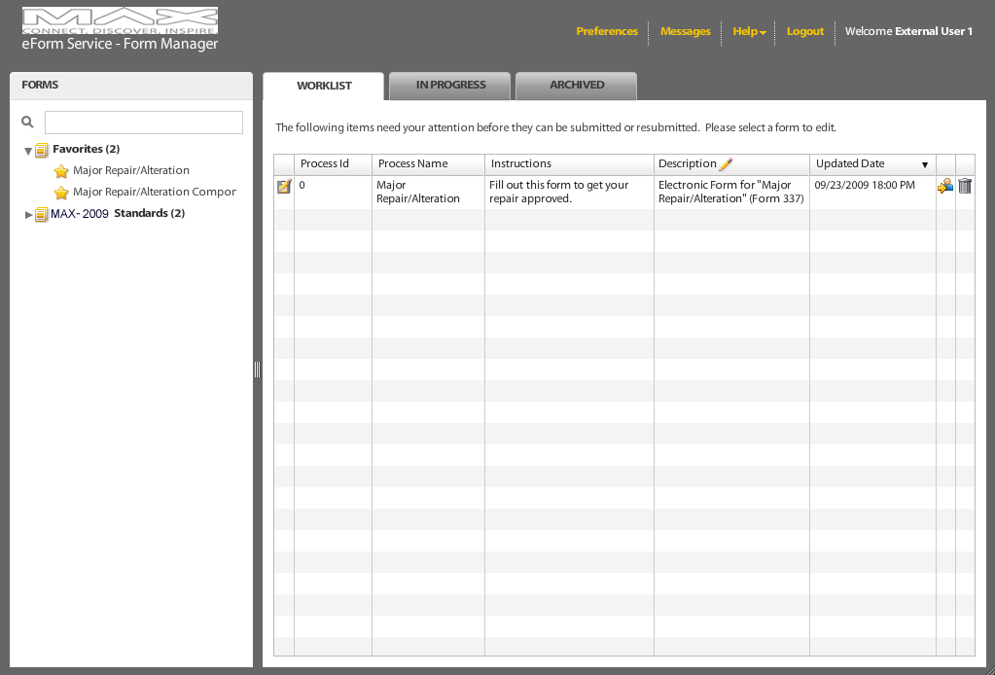
Customized Workspace
Notes:
-Here is the customized version that is basically a forms management ui
-tree structure to search and navigate the appropriate forms to select and fill-out.
-When the user clicks on the form tree on the left hand side, the PDF will appear on the right hand side
-

Slide 45
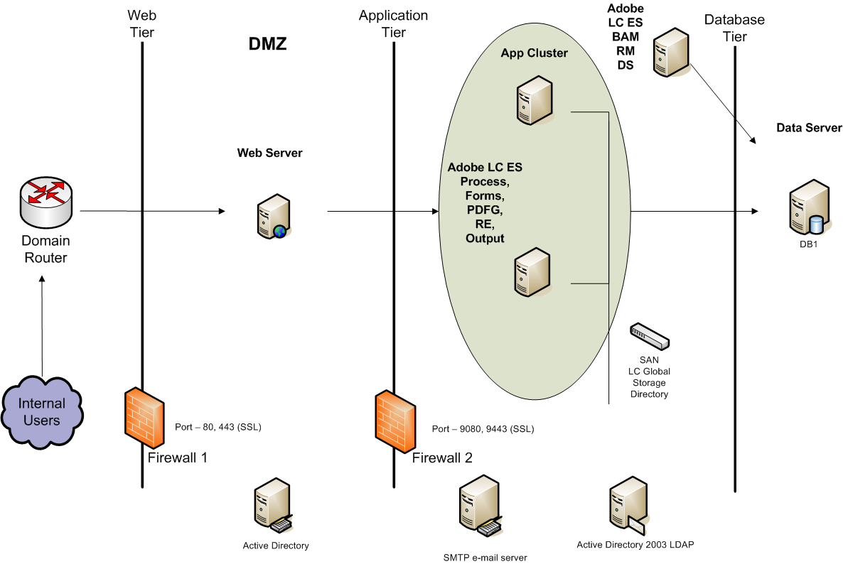
Solution architecture
Notes:
-Here is a fairly typical setup of LiveCycle within a 3 tier architecture.
-What I like to refer to it as the toaster style. In this case 4 slices
-The only major difference here is the separation of Rights Management and Digital signature into its own environment. I have seen this approach within many security concise clients in the past.

Slide 46
Summary
Identify the dots and then connect them
Understand what LC modules are required based on your requirements
Identify your integration end points
Avoid large upfront design and “cowboy”coding
Divide and conquer, start small and then go large - think atomic services
Test driven development, continuous integration
Using what you can out of the box to minimize risk, time to complete
Understand your users

Slide 47

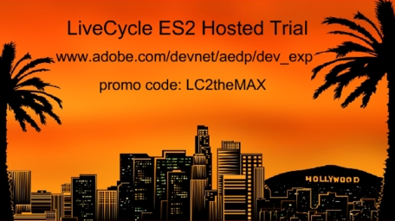
Get Started with LiveCycle ES2
Windows/JBOSS DVDs available here at MAX!
Stop by the LiveCycle station in the Adobe booth
First 250 developers to register can get hosted access online!
http://www.adobe.com/devnet/aedp/dev_exp/

Slide 48
Questions
?
dsaikaly@adobe.com

Slide 49


